Slide 1
Control size of context
2020-04-23
JuHyoung Kim
kjhkjh75@naver.com

Slide 2
- Process
Targeting the two major paper
Extract the weakness
Control the size of context
How to do experiment

Slide 3
- Weakness
Method level can`t fix dependent method
Class level is too large to learn specific context
Truncation may delete meaningful context

Slide 4
- Two paper
Tufano
1) method level
2) abstraction token
Sequencer
1) class level with truncation (maximum 1000 token)
2) FL
3) copy mechanism

Slide 5
- Control the size of context
Control the size with meaningful context
Represent dependency among methods
Make new sequence with dependent methods.
Class
{ unnecessary information
Method1
Method2
Method3
Method4
}

Slide 6
- Represent dependency method
Class
Method1
Method2
Method3
New sequence
Global variable -> Method1 -> Method3(FL)
6

Slide 7
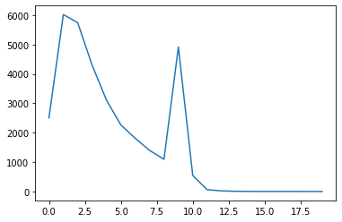
- Target Sequencer
Check the number of tokens (word level)
Test data set
100 | 200 | 300 | 400 | 500 | 600 | 700 | 800 | 900 | 1000 | 1100 | 1200 | 1300 | 1400<
2050 | 6019 | 5742 | 4299 | 3106 | 2264 | 1810 | 1397 | 1096 | 4915 | 546 | 62 | 20 | 15

Slide 8
- Make new sequence
Make new sequence with dependent methods.
Not exist other methods information in this sequence.
Global variable -> Method1 -> Method3(FL)
Do not consider order.

Slide 9
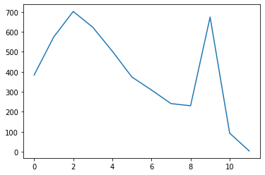
- Target Sequencer
- Test data set
100 | 200 | 300 | 400 | 500 | 600 | 700 | 800 | 900 | 1000 | 1100 | 1100<
384 | 574 | 702 | 623 | 503 | 374 | 309 | 241 | 230 | 674 | 93 | 6

Slide 10
- Experiment
Using sequencer data
Represent methods relation
Reduce input data size.
Check the learning and test result
1~2 weeks.

